Slide 1
INTERRUPTS
Lecture 10

Slide 2
INTERRUPTS
INT instruction is like a FAR call
When it is invoked, it saves CS:IP and the flags on the stack and goes to the subroutine associated with that interrupt.
It has following format:
INT xx ; xx can be 00 -FFh

Slide 3
INTERRUPTS
Most widely used interrupts are
10H
16H
21H
Each can perform many functions.
Before the service is requested, certain registers must have specific values

Slide 4
BIOS INT 10H
Many fuctions are associated with INT 10H
Changing the color of character or background color
Clearing the screen
Changing the location of the cursor

Slide 5
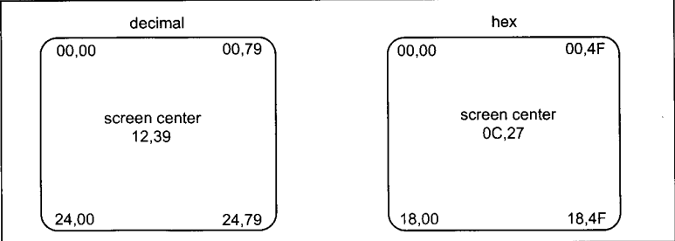
Monitor Screen in Text mode

Slide 6
Clearing the screen using INT 10H function 06H
;clearing the screen
mov ax, 0600h ;scroll the entire screen
mov bh,07 ;normal attribute
mov cx,0 ; row and column of top left
mov dx,184fh ; row and column of bottom right
int 10h ;invoke the video of BIOS service

Slide 7
Setting the cursor to a specific location INT 10H function 02H
mov ah,02 ;set cursor option
mov bh,00 ;page 0
mov dl, 10 ;column position
mov dh, 10 ; row position
int 10h ; invoke interrupt 10h

Slide 8
INT 10H function 03: Get Current Cursor Position
mov ah,03
mov bh,00
int 10h

Slide 9
INT 10H function 09: Write a character and its attribute at the cursor position
Register used
AH = 9H
AL = ASCII value
BH = Display page
BL = Attribute
CX = Number of characters to write

Slide 10
INT 10H function 09: Write a character and its attribute at the cursor position
mov ah,09 ;display option
mov bh,00 ;page 0
mov al,44h ;ascii character to display
mov cx, 200h ;repeat 200h times
mov bl,1fh ;black on white blinking
int 10h

Slide 11
INTERRUPTS
The processor uses the interrupt number to index the Interrupt Vector Table (IVT) to get the address of a special type of procedure called an Interrupt Service Routine (ISR).
The ISR is executed whenever the interrupt is generated.
There are 256 entries in IVT, and each entry stores the logical address of a respective ISR.
IVT resides in memory at physical address 0x00000.
Each entry stores the logical address, which is 4 bytes; the total size of the IVT is 256 x 4B = 1 KB.
To index the IVT, the processor multiplies the interrupt number by 4 to get the physical address of the entry against that interrupt number

Slide 12
ISR
ISR is a special procedure that is called whenever an interrupt is generated.
Whenever an ISR is called as a result of an interrupt, the flag register is pushed onto the stack along with IP and CS.
Therefore, unlike procedures, the ISRs return control by issuing "IRET" instructions instead of "RET" instructions.
The IRET instruction also pops the flag register from the stack, whereas the RET instruction does not.

